Slide 1

Active Learning Initiative
University of Alabama Arts and Sciences
Active Learning Initiative
Creating and Using Rubrics in the Active Learning Classroom
Jessica Fordham Kidd
Marvin E. Latimer Jr., Ph.D.
Sarah Marshall, M.F.A.
Lucy Curzon, Ph.D.

Slide 2
Workshop Overview:
Present Theoretical Overview
Introduce a writing exercise (“listing” or “clustering”) as an invention technique.
Show how clustering applies to rubric writing.
Create word clusters based on sample projects in your discipline.
Write a brief vignette that encapsulates values and areas you wish to emphasize.
Create draft rubrics based on these written vignettes.

Slide 3
Relevant Theoretical Models
(Back to the Future)
  Capability Ability Clusters:
    Imitative
    Expressive/Interactive
    Exploratory
  Learning Theory-Humans learn better…
    In groups
    When included in decisions
    When new information connects to old information
    When we can relate learning to real life experiences
    When we are happy!

Slide 4
Assessment Measures
(Back to the Future)
Shift from assessing rote learning and memorization to assessment of abilities (esp. higher order domains).
ALI focuses on affording students an opportunity to practice skills.
Ideally, this should happen prior to the final assessment.
Hence, the need to develop formative and summative assessment strategies.
Formative: during the learning process.
Summative: following the learning process.
Which leads us to…….

Slide 5
Rubrics Defined
Rubrics:
Are scoring tools that lay out the expectations for a specific assignment.
Divide an assignment into its component parts.
Provide discursive statements of what constitutes acceptable or unacceptable levels for each of those parts.
Usually are constructed using a matrix.
Stevens, D. & Levi, A. (2005). Introduction to Rubrics. Sterling, VA: Stylus Publishing.

Slide 6
Why Rubrics: Teacher Perspective
Efficiency, consistency, and objectivity (watch out here!).
Implicitly know what makes an assignment excellent, mediocre, or in need of improvement.
Evaluations more closely replicate real life experiences
Focus attention on the key concepts and standards that the students must obtain.
Provide the scaffolding necessary to improve the quality of students' work.
Increase the knowledge that the students acquire.
Allow teachers to accommodate heterogeneous classes by offering a range of quality levels (i.e., they can be used with broad ranges of students in the same class).
http://www.teachersfirst.com/lessons/rubrics/why-use-rubrics.cfm

Slide 7
Why Rubrics: Student Perspective
Clear understanding of what is expected of them.
Concrete directions about what makes a good science project, persuasive writing piece, art work, musical performance, etc.
Research has suggested that rubrics improve students' end products and thus increase the students' overall learning.
Provide students with valuable information about the degree of which a specific learning outcome has been achieved.
Concrete feedback that displays areas of strength and areas in need of improvement.
Students think about their own thinking and possibly about their own criteria for what is "good.”
Analyze their own work in relation to a standard.
http://www.teachersfirst.com/lessons/rubrics/why-use-rubrics.cfm

Slide 8
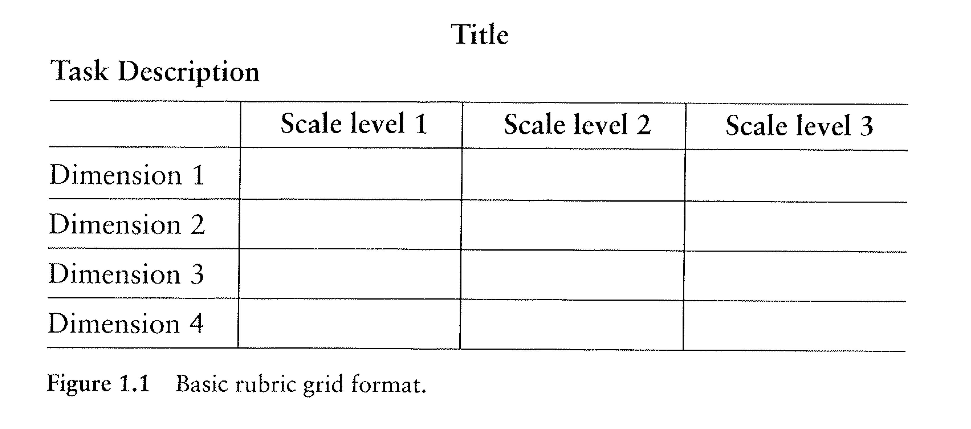
Basic Grid Format
Stevens, D. & Levi, A. (2005). Introduction to Rubrics. Sterling, VA: Stylus Publishing.

Slide 9
Constructing a Rubric
Four Key Stages:
Reflection…
Listing/Clustering…
Grouping and Labeling…
Application…
Stevens, D. & Levi, A. (2005). Introduction to Rubrics. Sterling, VA: Stylus Publishing.

Slide 10
For Example

Slide 11
WHY are you here?
(our assumptions)
You were attracted by the idea of improving your rubrics or feel a sense of dissatisfaction with those you already have in place.
You feel some ambiguity about the usefulness of rubrics and are looking for persuasive evidence of their efficacy.
Your professional situation dictates the implementation of rubrics for retention, accreditation, and quality enhancement.
Coordinate departmental standards across a broad range (multiple sections of introductory courses, facilitate grading by multiple instructors).

Slide 12
Creating Better Rubrics
Create rubrics that:
  truly reflect your goals and values; the places that you find joy in teaching
  incorporate students’ goals and values
  encourage happy accidents, blundering, back-tracking, etc. (i.e., that don’t privilege only traditional, linear thinking).
  facilitate peer and self-assessment
  Find creative or innovative ways to measure and describe quality.

Slide 13
Rubrics – Strengths
Provide structure when a wide field of possibilities can be overwhelming/paralyzing.
Improve communication by providing common standards for evaluating performance.
Introduce vocabulary and provide practice that are used useful skills for analyzing and evaluating (Bloom’s).
Provide a tool for self-assessment before projects are critiqued/graded.
Tease apart different components that go into the act of making/creating.

Slide 14

Rubrics – Supporting
Introverted Students
Outlines research indicating that group dynamics strongly affect thought and behavior
Introverted students often lose their voice during group and collaborative learning activities.
http://www.thepowerofintroverts.com/about-the-book/
Notes:
Susan speaks about her book as part of the TED program. Rubrics can offer a standard/measure for use during contemplative periods and for analyzing work away from the group.

Slide 15
Rubrics – Weaknesses
Create a false sense of security when working, which evaporates when student works without the guidance of a rubric.
Functions as a formula or algorithm, i.e., attempts to methodize the creative process.
Potentially fruitful paths eliminated by attempt to move most efficiently to a given endpoint.
Sense of conformity, being constrained or “boxed in”.
Don’t acknowledge role of synergy in quality of final projects, i.e., doing well in all measures doesn’t always equal the best work.

Slide 16
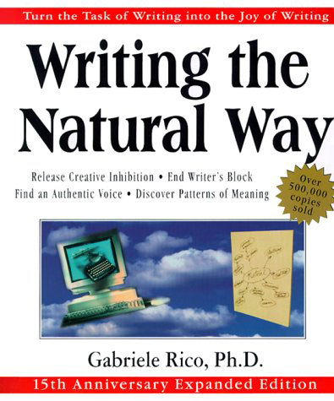
Rubrics – Gabrielle Rico
In teaching our students to be active learners, we often get the most done by tolerating ambiguity and resisting the desire to see ahead of time exactly where we are going.

Slide 17
Rubrics – Clustering or
Listing (Why?)
“Clustering” or spontaneous “listing” can bypass logical, orderly, linear qualities of thought.
Create connections that might not otherwise have occurred.
Generate ideas quickly by unfolding them from a central concept.
Explore associations BEFORE finalizing an order and structure.
Clustering or spontaneous listing works because it is a reflection of the way our mind naturally works.

Slide 18
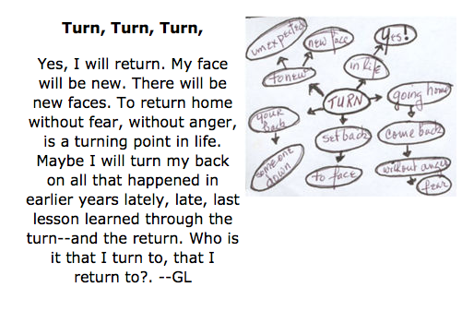
Rubrics –
Clusters and Vignettes
http://www.gabrielerico.com/Main/ClusteringSampleVignettes.htm

Slide 19
Rubrics –
Clustering/Listing Exercise
Choose a single word related to an assignment that you give to students, or related to studies in your discipline.
Write and circle the word in the upper third of the page, leaving the lower area for additional writing.
Write down all the words you associate with your beginning word. Work quickly, allow random associations, don’t self-censor.
If you begin to focus on another word, cluster the associations around it. If you get stuck, doodle on your existing work.
You will know when to stop when you experience an “a-ha” moment or recognizing a pattern.
Notes:
You could start with any word; a medium, an artist, a kind of project, the title of the project, etc.
Demonstrate on the board using “intaglio”.

Slide 20
Rubrics –
Vignette Exercise
Begin writing in phrase/sentence form.
Refer to your cluster or ignore it completely; the process of making the cluster has created the patterns in your mind
Don’t feel that you must use everything in the cluster, or that you cannot add things that occur to you while writing.
Re-read (read aloud) the piece you’ve just written. You can focus more on your editorial voice at this point.
Stop when you have a strong sense that everything in your vignette “belongs”.

Slide 21
Rubrics –
Vignette to Rubric
Using the other side of the page, fit your vignette into the rubric table.
Label your axes and fill in descriptions.
Dimensions (things being measured) (going across)
Rankings (standards for measuring) (going down)
Criteria (descriptions of standards) (fill in grid)
 | Skill | Vocabulary | Synthesis
Excellent
Fair
Poor

